Slide 1
PREDICTING FIBRE CLASSIFICATION FOR MITOCHONRIOAL DISEASE DATASETS USING CLUSTERING TECHNIQUES
MSc Data Science Project and dissertation 2020/21
by Frestie Ngongo
Classification_of_fibres from the mitochondrial_disease_dataset_using_Clustering_techniques

Slide 2
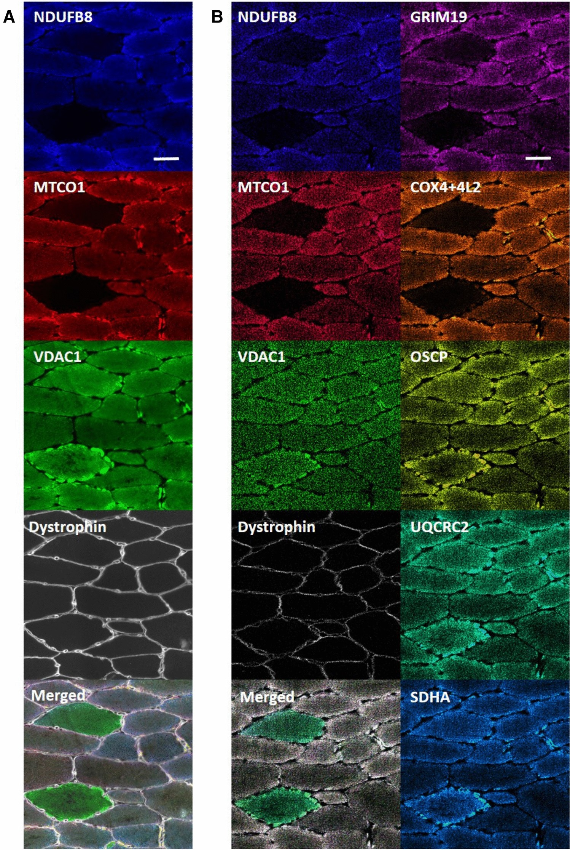
Background to the Project
Clinical data collected from 13 anonymous patients – 10 with mitochondrial disease and 3 without the disease (as control)
Dataset produced by Imaging Mass Cytometry (IMC) in a prior study by Warren et al., 2021
They identified that a deficiency in oxidative phosphorylation proteins was a characteristic of mitochondrial disease.
Classification as having the Mitochondrial Disease was based on the proteins that are part of the respiratory chain (RC), which is a step in oxidative phosphorylation.
Looked at two proteins – NDUFA13 and NDUFB8 and their ability to be used to classify a fibre as RC deficient and non-RC deficient using unsupervised learning models:
K-means Clustering
Gaussian Mixture Model
Notes:
CI had almost 100% of fibres as RC deficient so this met expectations considering what we know about CI and the reactive chain.

Slide 3
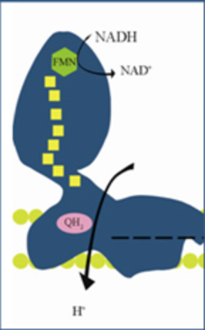
Proteins
Complex I
The 2 proteins investigated in this study were:
NDUFB8
NDUFA13
Both are part of Complex I (CI) of the respiratory chain and are used in the oxidative phosphorylation process during the transfer of electrons in the respiratory chain for the release of energy for the cell.
Why them?
Using these proteins because complex I (CI) is known to be deficient in patients with mitochondrial diseases, which would correlate with deficiencies of these proteins, hence a deficiency in the respiratory chain protein.
Notes:
The image on the right is complex I and the NDUFA13 and NDUFB8 are part of this complex.

Slide 4

Work Undertaken
log(protein expression) for the 8 proteins of all the 9000 fibres
Created a data frame consisting only the proteins, patient type, patient ID, cell ID, subject group
Analysed the raw data – presented as a scatterplot of log(protein expression) vs the log(VDAC1) protein expression.
Predicted clustering of all 9000 fibres using k-means and GMM clustering models
Calculated proportions of fibres classified as RC (Respiratory chain) deficient for each patient/control, followed by the proportion for each disease type.

Slide 5
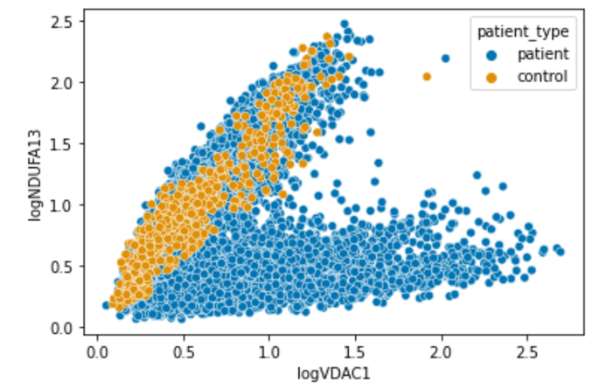
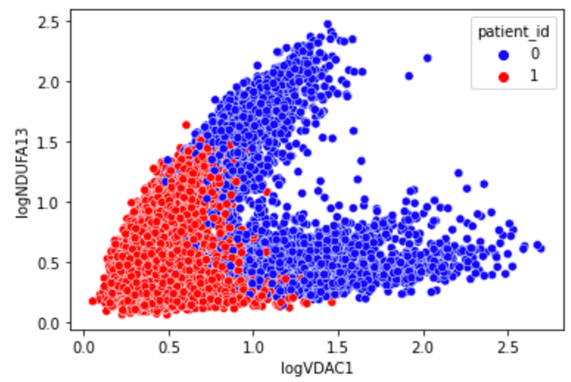
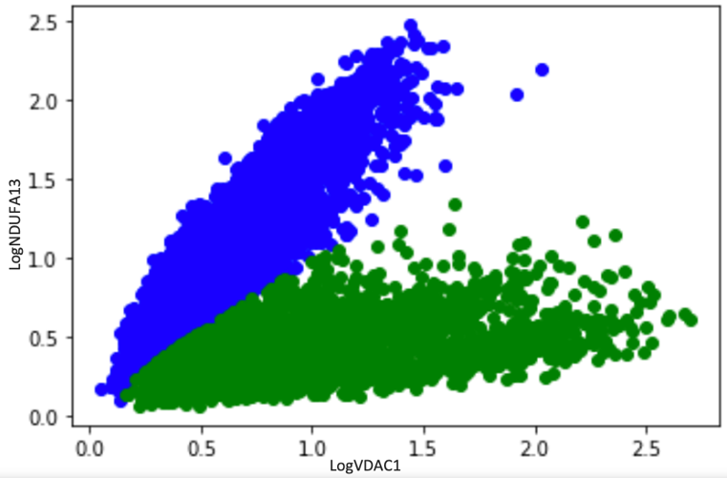
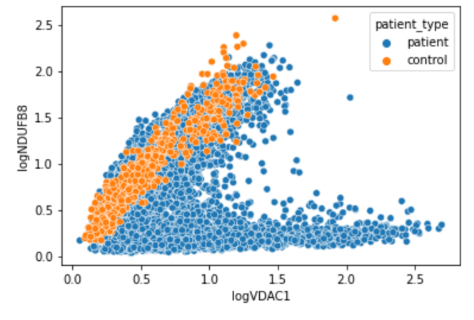
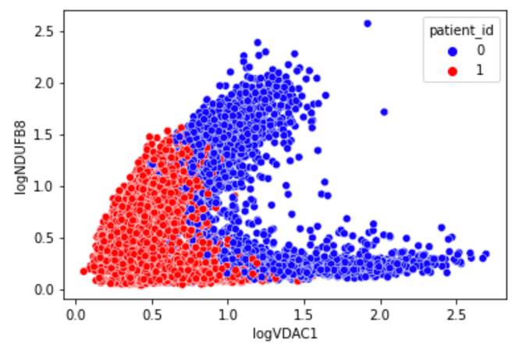
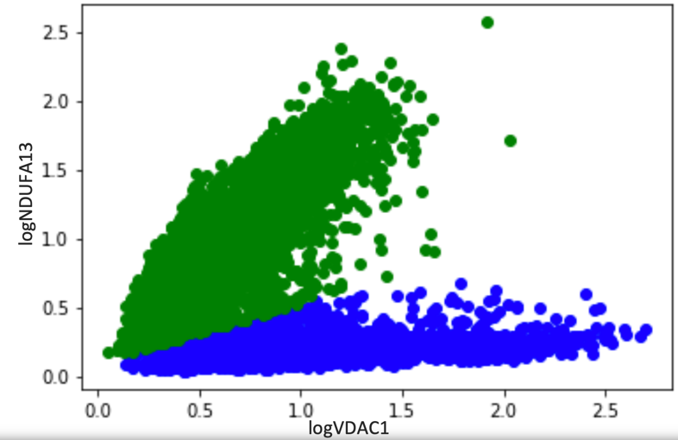
Key Findings
Comparing both the GMM and k-means plots of the two proteins, GMM produced a split that corresponds to the natural split of the data seen in the plot, whereas k-means did not, although it produced two clusters.
logNDUFB8
Notes:
We expected the two proteins to produce a similar scatterplot outcome considering they are both part of the same complex I of the respiratory chain.

Slide 6
K-means
Individual | Proportion of RC deficient Fibres (%) | Disease Type | Proportion of RC deficient Fibres (%)
C01 | 1.4%
C02 | 0% | Control | 19.0%
C03 | 80.9%
P01 | 97.6% | CI | 98.1%
P02 | 98.7%
P03 | 0.8% | Deletion | 33.8%
P04 | 84.8%
P05 | 20.1%
P06 | 76.4% | MT-TL1 | 39.8%
P07 | 49.5%
P08 | 54.8% | MT-TG | 54.8%
P09 | 50.2% | MT-TE | 50.2%
P10 | 80.9% | MT-TW | 80.9%
The control, especially C03 had a high proportion of RC-deficient fibres which was unexpected.
CI had almost 100% of fibres as RC deficient so this met expectations
New finding that deletion and MT-TL1 disease types had varying proportions for each patient which was surprising.
Notes:
CI had almost 100% of fibres as RC deficient so this met expectations considering what we know about CI and the reactive chain.

Slide 7
GMM
Results from both proteins show that the GMM predicted the control as close to 0%.
CI fibres were predicted to be approximately 100% RC deficient
Both patients with the deletion variant were predicted to have a very low proportion of RC deficient fibres
MT-TL1 is still showing each patient with varying RC deficient fibre proportions – likely that other factors play a role in the classification of this disease e.g. deficiency of other proteins produced by tRNA for oxidative phosphorylation
The remaining diseases have a high proportion of RC deficient fibres
NDUFB8
NDUFB8
NDUFA13
Individual | Proportion of RC deficient Fibres (%) | Disease Type | Proportion of RC deficient Fibres (%)
C01 | 0.7%
C02 | 2.1% | Control | 1.4%
C03 | 0%
P01 | 99.7% | CI | 99.8%
P02 | 100%
P03 | 3.8% | Deletion | 4.0%
P04 | 4.3%
P05 | 23.7%
P06 | 11.3% | MT-TL1 | 30.7%
P07 | 68.9%
P08 | 87.3% | MT-TG | 87.3%
P09 | 42.5% | MT-TE | 42.5%
P10 | 83.6% | MT-TW | 83.6%
Individual | Proportion of RC deficient Fibres (%) | Disease Type | Proportion of RC deficient Fibres (%)
C01 | 0%
C02 | 0.3% | Control | 0.2%
C03 | 0%
P01 | 100% | CI | 100%
P02 | 100%
P03 | 2.6% | Deletion | 1.5%
P04 | 3.4%
P05 | 21.4%
P06 | 9.5 % | MT-TL1 | 28.2%
P07 | 65.3%
P08 | 83.6% | MT-TG | 83.6%
P09 | 37.7% | MT-TE | 37.7%
P10 | 80.9% | MT-TW | 80.9%

Slide 8
Conclusion
The k-means vs GMM models:
Visual inspection of 2Dmito plots shows GMM captures the two forks of the V-shaped data whilst k-means does not
Quantitative inspection:
Control expected to be 0%, GMM shows this but k-means does not
CI expected to be 100%, both GMM and k-means show this
Deletion expected to be low but the same for both patients which GMM shows. However, k-means shows varying results for each patient.

Slide 9


